Slide 1
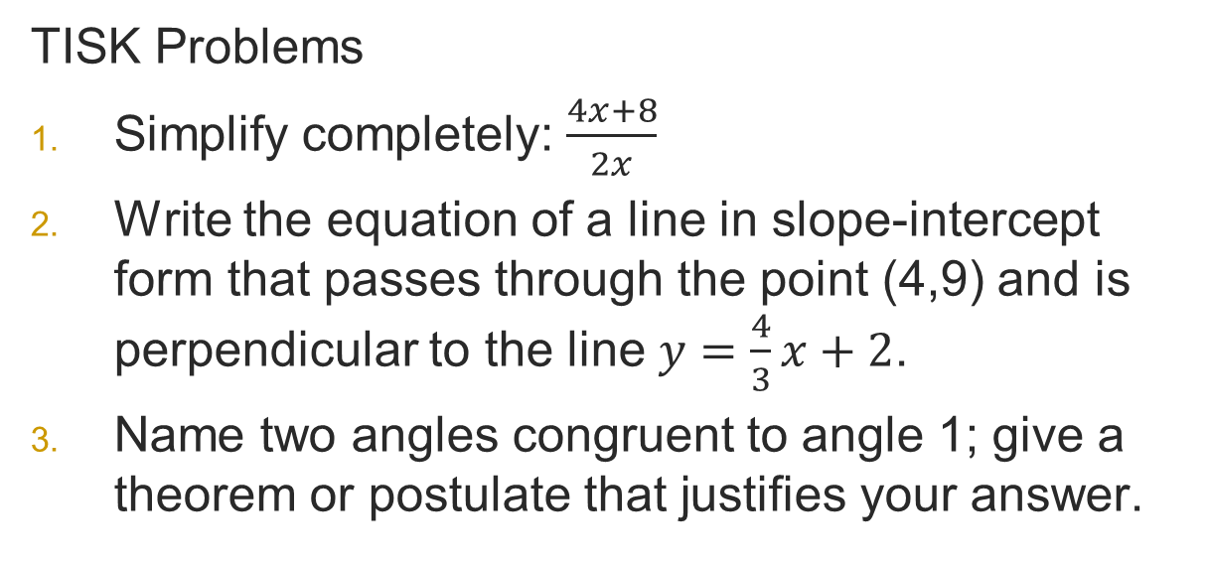
Monday, February 4, 2013
Agenda:
TISK, No MM
Homework Check
Lesson 9-2: Angles & Arcs
Homework: 9-2 problems in packet
TISK Problems
Simplify completely: $\frac{4x+8}{2x}$
Write the equation of a line in slope-intercept form that passes through the point (4,9) and is perpendicular to the line $y=\frac{4}{3}x+2$.
Name two angles congruent to angle 1; give a theorem or postulate that justifies your answer.
1
2
4
3
5
6
8
7

Slide 2
Graded Work
Chapter 7 Test
  9A
    Class Average: 70.8%
    Class Median: 73.8%
    Highest: 98.8%
    Lowest: 27.6%
  9B
    Class Average: 84.6%
    Class Median: 82.7%
    Highest: 100%
    Lowest: 70%

Slide 3
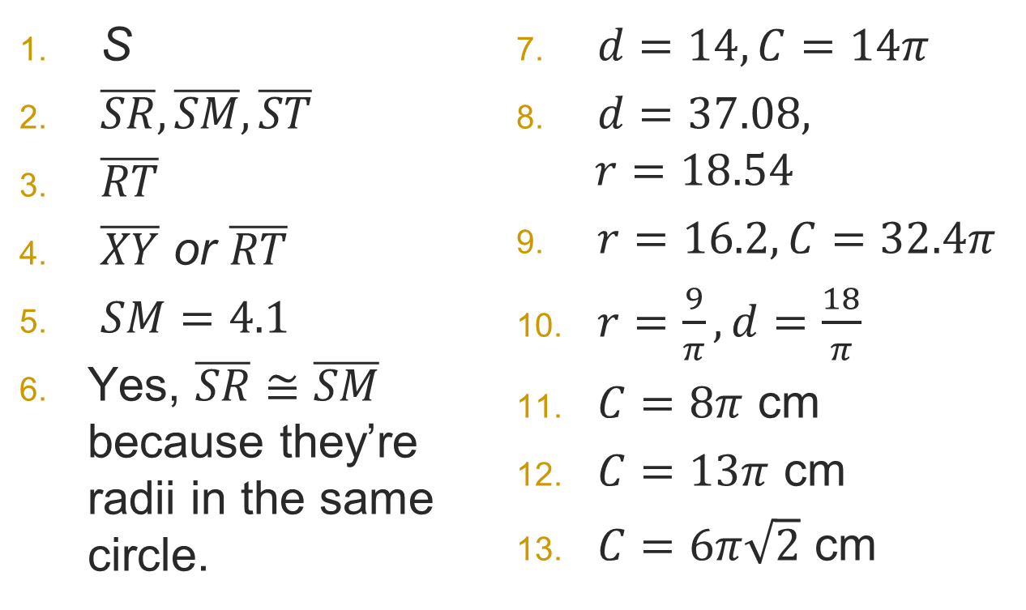
Homework Check
S
$\overline{SR},\overline{SM},\overline{ST}$
$\overline{RT}$
$\overline{XY}$ or $\overline{RT}$
$SM=4.1$
Yes, $\overline{SR}≅\overline{SM}$ because they’re radii in the same circle.
$d=14,C=14π$
$d=37.08,$
$r=18.54$
$r=16.2, C=32.4π$
$r=\frac{9}{π}, d=\frac{18}{π}$
$C=8π$ cm
$C=13π$ cm
$C=6π\sqrt{2}$ cm

Slide 4
§9.2 Angles & Arcs
Definitions
  Arc: part of the circumference of a circle.
  Major Arc: more than half a circle
  Minor Arc: less than half a circle
  Semicircle: Exactly half a circle
Naming Conventions
  When naming arcs, we use:
  This convention always indicates the SHORTEST path from A to B.
  To name a major arc or semicircle, we thus need three letters:
B
C
A

Slide 5
Practice: Name the shaded arc in each picture.
Then tell whether it is a minor arc, major arc, or a semicircle.
D
B
C
A

Slide 6
Practice: Name the shaded arc in each picture.
Then tell whether it is a minor arc, major arc, or a semicircle.
E
H
F
G

Slide 7
Practice: Name the shaded arc in each picture.
Then tell whether it is a minor arc, major arc, or a semicircle.
L
N
K
M
J

Slide 8
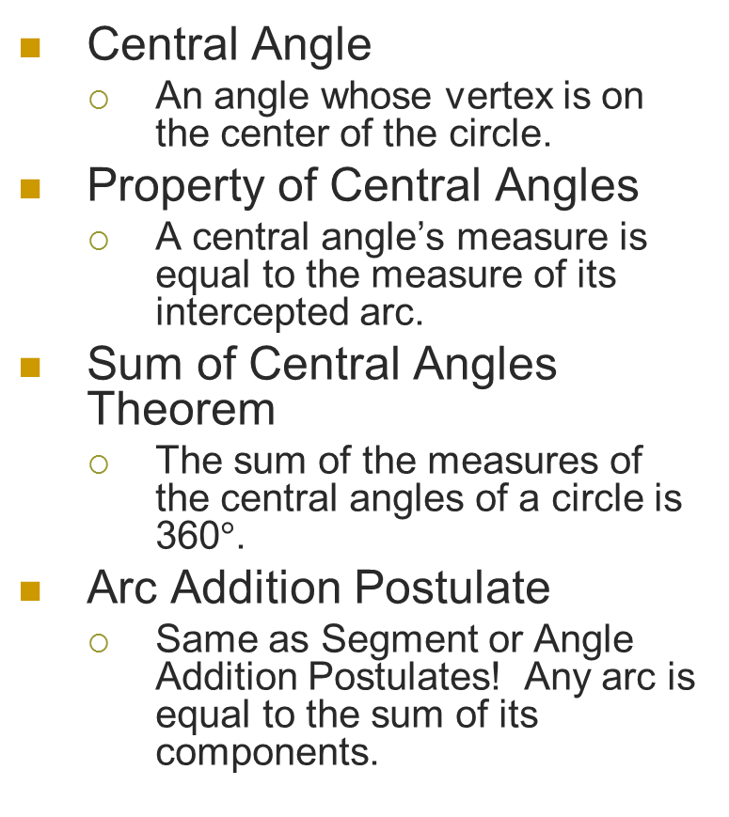
Definitions, Properties, Theorems, & Postulates
Central Angle
  An angle whose vertex is on the center of the circle.
Property of Central Angles
  A central angle’s measure is equal to the measure of its intercepted arc.
Sum of Central Angles Theorem
  The sum of the measures of the central angles of a circle is 360$°$.
Arc Addition Postulate
  Same as Segment or Angle Addition Postulates! Any arc is equal to the sum of its components.
C
A
B

Slide 9

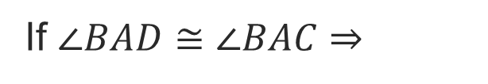

Theorem
In the same circle, or in congruent circles, two arcs are congruent if and only if their corresponding central angles are congruent.
D
If $∠BAD≅∠BAC⇒$
B
If $⇒$
$$∠BAD≅∠BAC$$
A
C

Slide 10
Practice. Find the indicated measure.
A
D
140º
B
C

Slide 11
Practice. Find the indicated measure.
K
L
90º
M
J
100º

Slide 12
Practice. Find the indicated measure.
X
105º
W
Y
Z

Slide 13
Practice. Find the indicated measure.
W
R
xº
5xº
J
L
T

Slide 14
More Definitions
Definitions
  Concentric circles
Two circles with the same center, but different radii.

Slide 15
Congruent Arcs
Recall:
  In the same circle, or in congruent circles, two arcs are congruent if and only if their corresponding central angles are congruent.
  Why do they have to be in the same or congruent circles?

Slide 16
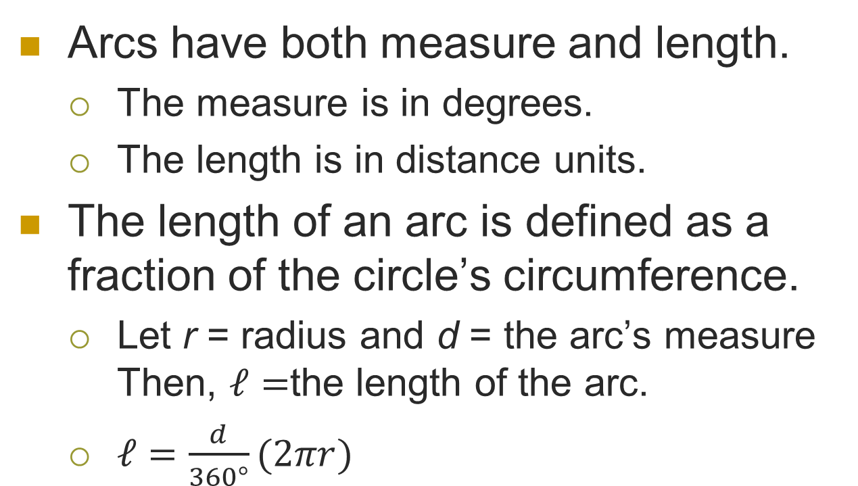
Arc Length
Arcs have both measure and length.
  The measure is in degrees.
  The length is in distance units.
The length of an arc is defined as a fraction of the circle’s circumference.
  Let r = radius and d = the arc’s measure
  Then, $ℓ=$the length of the arc.
  $ℓ=\frac{d}{360°}(2πr)$

Slide 17
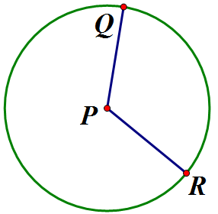


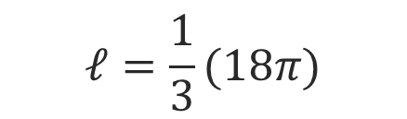
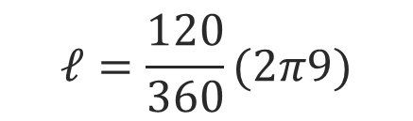

Example
Find the length of given , $PR=9$ and
$m∠QPR=120°$.
$$ℓ=\frac{120}{360}(2π9)$$
$$120°$$
$$ℓ=\frac{1}{3}(18π)$$
9 u
$$ℓ=6π units$$

